Slide 1
Cognitive Neuroscience and NLP
CPSC 677, Fall 2020
Sam Fereidooni

Slide 2
What exactly is cognitive neuroscience?

Slide 3
Cognitive Neuroscience
Cognitive neuroscience ⊆ neuroscience
“A field of study that investigates the relationship between the brain and the mind.”
Aims to find the biological processes that underlie human cognition
MIND
In health and disease
Across the life span
BRAIN

Slide 4
Common Brain Imaging Techniques
Non-invasive:
Functional magnetic resonance imaging (fMRI) is the technique of measuring brain activity by detecting changes in blood flow and oxygenation
Increase in neural activity → more oxygenated blood → increase in MRI signal
Electroencephalography (EEG) is the technique that detects electrical activity in the brain using electrodes placed on the scalp
Magnetoencephalography (MEG) is the technique of measuring the magnetic fields produced by electrical activity in the brain
https://www.newhavenbiz.com/article/yale-president-opens-imaging-center-with-brain-power

Slide 5
Common Brain Imaging Techniques (2)
Invasive:
Electrocorticography (ECoG), or intracranial EEG, refers to the technique of recording neural activity from electrodes placed on the exposed surface of the brain
Microelectrode arrays are devices that are often implanted into the brain to record the spiking activity of neurons (up to several thousand simultaneously, to date)
https://www.cityweekly.net/utah/brain-chip-may-help-the-blind-see

Slide 6
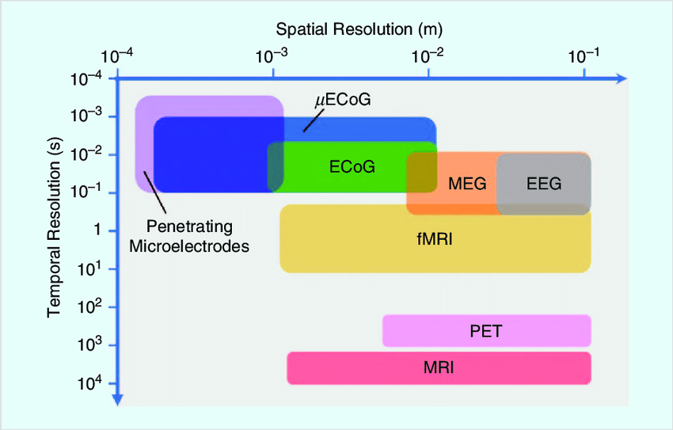
Common Brain Imaging Techniques (3)
https://www.researchgate.net/publication/322549090_Soft_Neural_Interfaces_for_Ultrathin_Electronics

Slide 7
What has work borrowing from cognitive neuroscience aimed to accomplish in NLP?

Slide 8
1) Evaluation

Slide 9
2) Improving performance

Slide 10
3) Interpretability

Slide 11
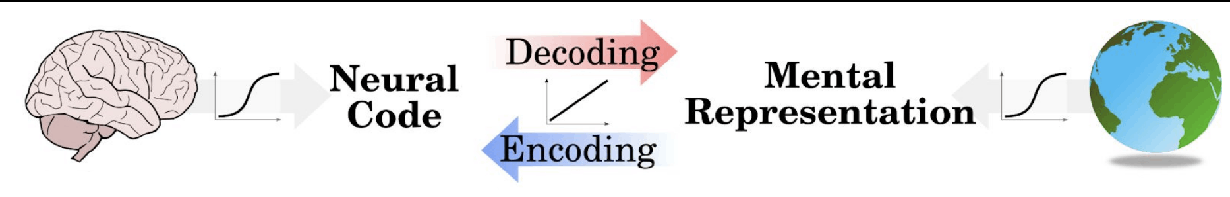
Brain Image Encoding and Decoding
Encoding models
Predict the pattern of brain activity elicited by a particular set of experimental conditions
Decoding models
Predict the experimental condition(s) (or their proxies) that elicited a certain pattern of brain activity
https://hal.archives-ouvertes.fr/hal-01848442/document

Slide 12
Paper #1: “Predicting Human Brain Activity Associated with the Meanings of Nouns”
Tom M. Mitchell, Svetlana V. Shinkareva, Andrew Carlson, Kai-Min Chang, Vicente L. Malave, Robert A. Mason, Marcel A. Just
Science

Slide 13
Mitchell et al. (2008), Overview
First large-scale study to demonstrate that words (concrete nouns in this case) can be predicted from brain imaging data
Authors encode fMRI data by learning a linear mapping with a distributional semantic model (based on word co-occurences with 25 manually selected verbs)
All participant models predicted brain activity significantly above chance levels, and features learned by the linear mapping cohere with findings in cognitive neuroscience

Slide 14
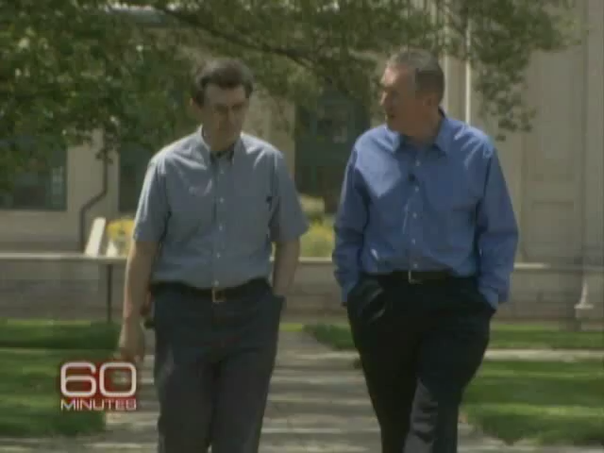
Mitchell et al. (2008), 60 Minutes
https://www.cbsnews.com/news/reading-my-mind/

Slide 15
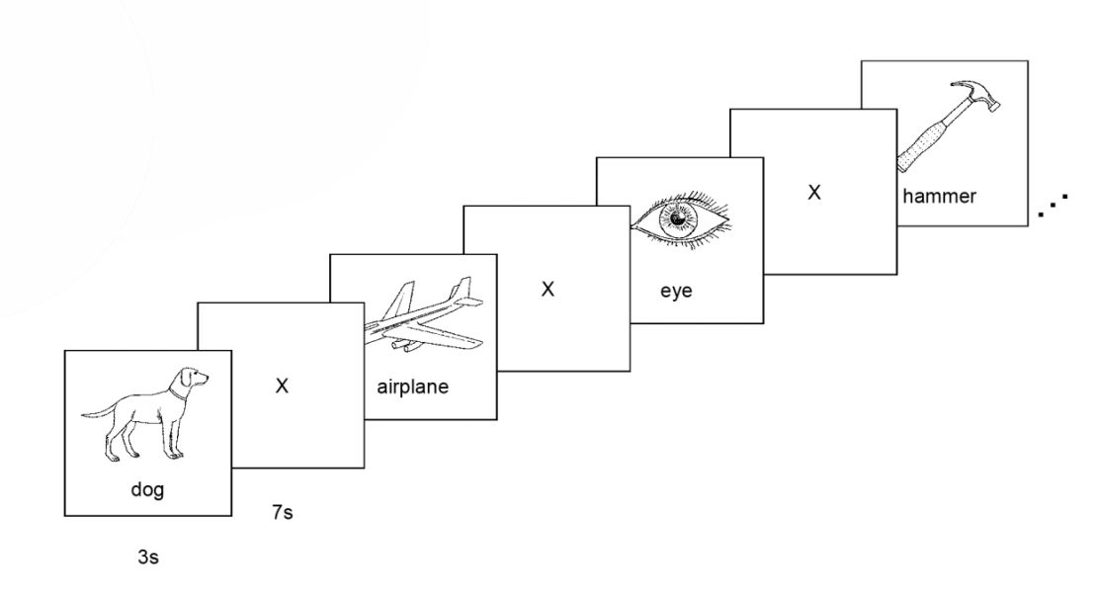
Mitchell et al. (2008), Method
fMRI data:
fMRI data was collected from 9 participants, as each was presented with 60 concrete nouns (and their corresponding line drawings)
Stimuli included 5 items from each of 12 semantic categories (animals, body parts, tools, etc.)
During preprocessing, only data from the 500 most stable voxels was used (the voxels that exhibited consistent variation in activity across presentations)
https://learning.acm.org/binaries/content/assets/leaning-center/webinar-slides/2017/mitchell_acmwebinar_june2017_final.pdf

Slide 16
Mitchell et al. (2008), Method (2)
Distributional semantic model:
The authors chose 25 verbs (referred to in the paper as “semantic features”) to serve as a proxy for sensory-motor features:
see, hear, listen, taste, smell, eat, touch, rub, lift, manipulate, run, push, fill, move, ride, say, fear, open, approach, near, enter, drive, wear, break, and clean
The word vector representation for each concrete noun consisted of a 25-dimensional vector of the word’s co-occurences with each of the 25 verbs (in a large text corpus)

Slide 17
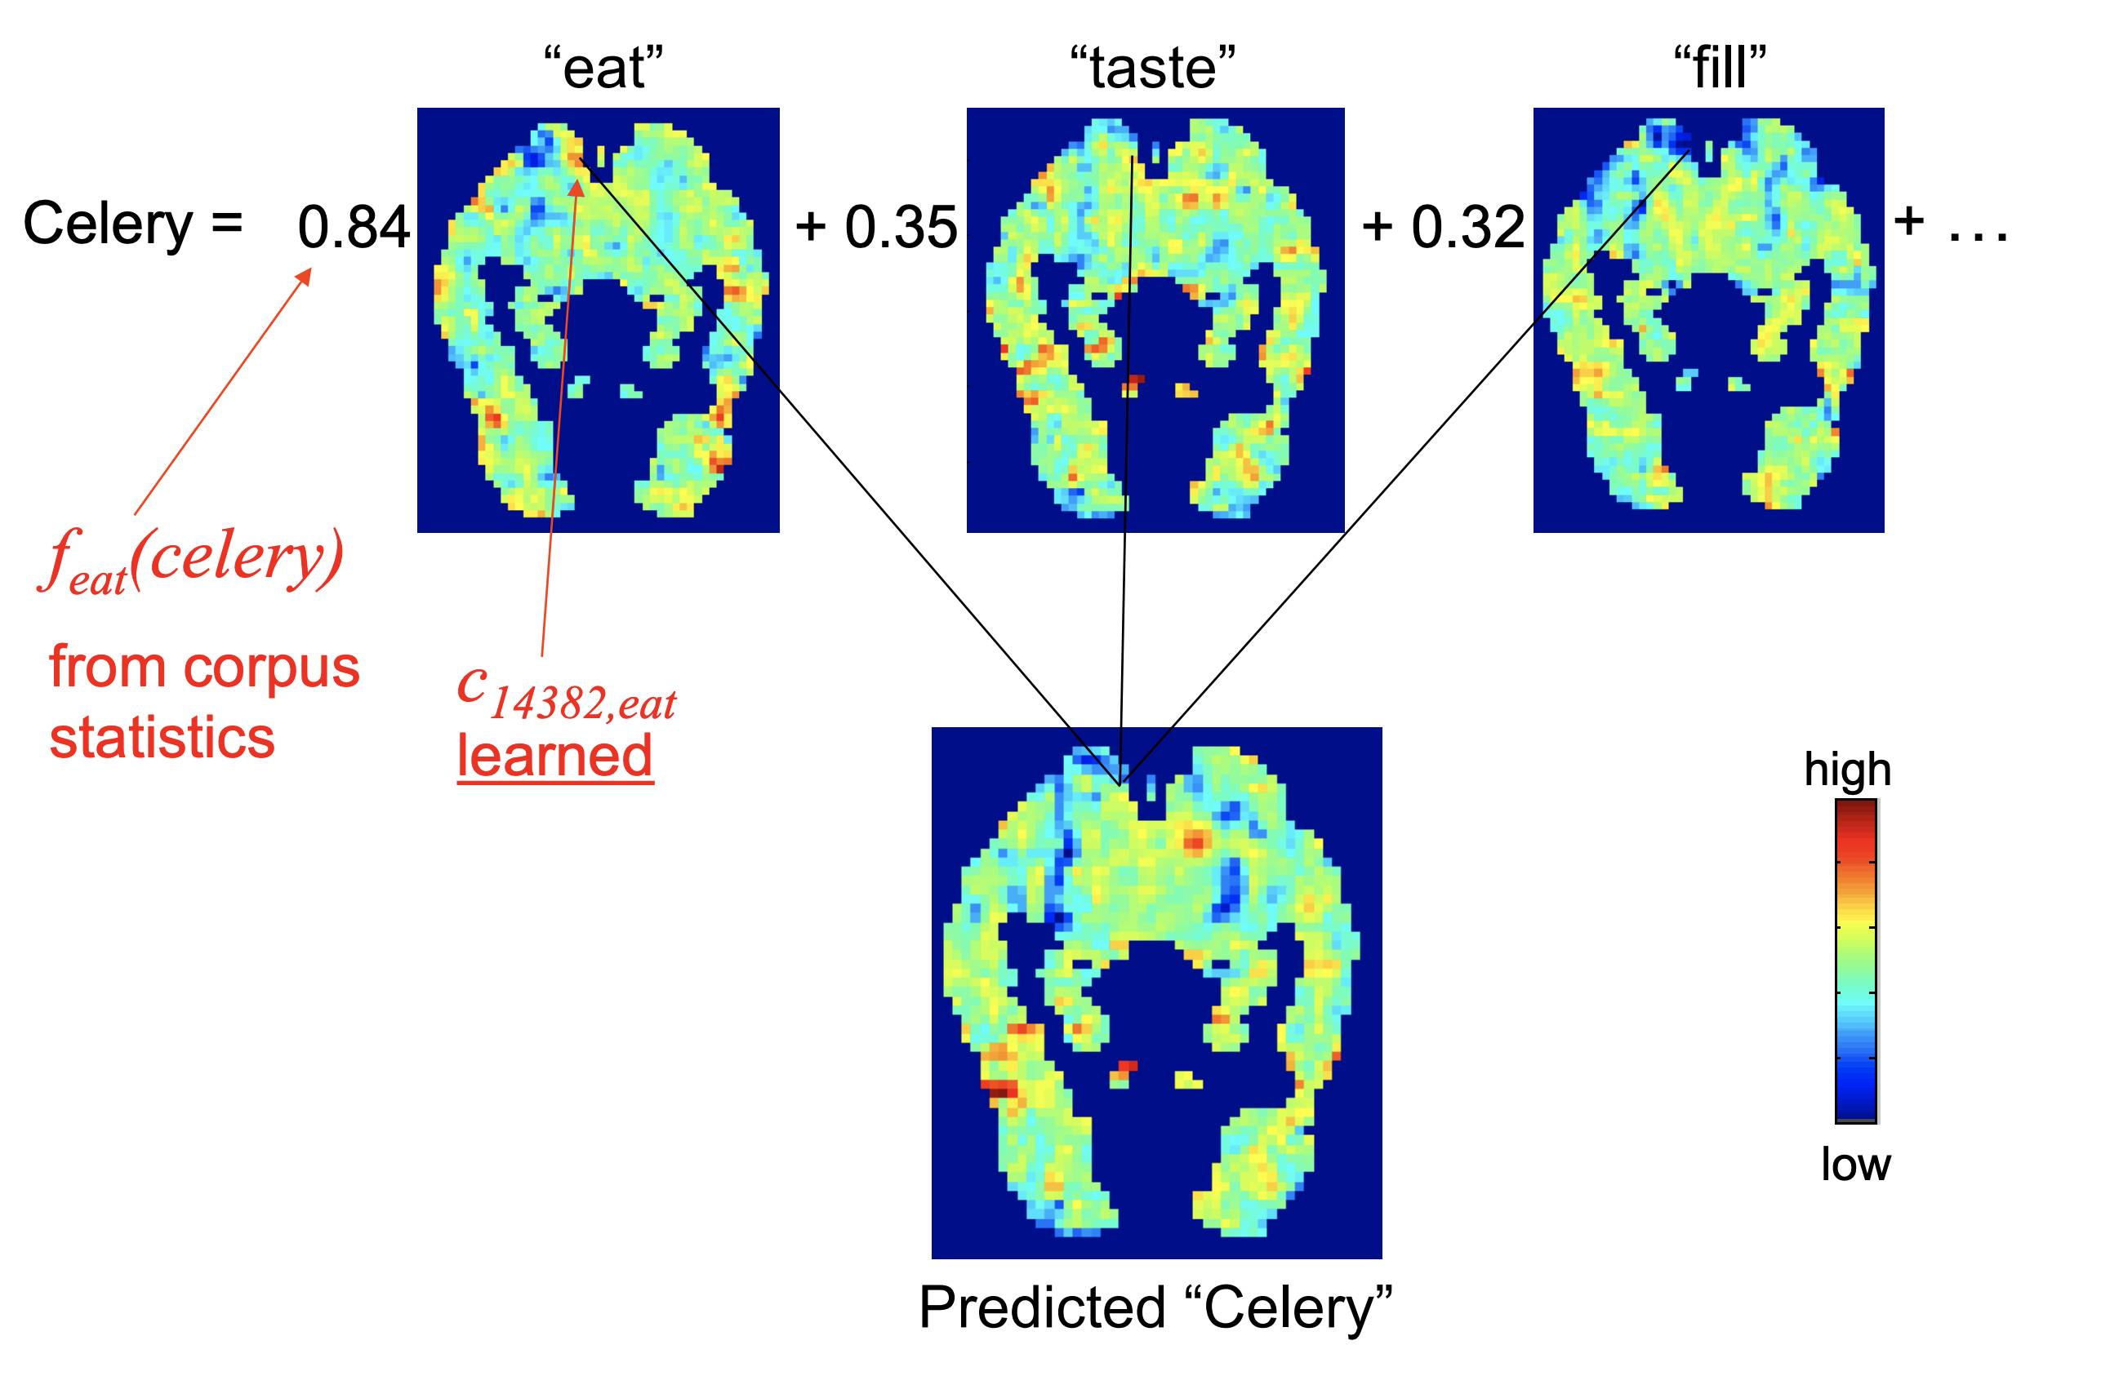
Mitchell et al. (2008), Method (3)
Brain image encoding model:
Linear regression models were trained to predict activation in each voxel using the 25-dimensional word vector of a given concrete noun
Models were trained and evaluated on individual participant’s data (as is common in cognitive neuroscience)

Slide 18
Mitchell et al. (2008), Method (4)
Evaluation:
Models were trained using leave-two-out cross validation. For each participant, a model was trained on each group of 58 of the 60 concrete nouns and tasked with correctly predicting the brain recordings for the two left-out words
The cosine similarity between these two predicted recordings and the actual recordings of the two left-out words were computed to determine if the model’s predictions were accurate
Based on permutation testing, the authors determined that a model accuracy of 0.62 (for each participant) would be significant at p < .05 from a distribution of null models

Slide 19
Mitchell et al. (2008), Results
All nine participants exhibited accuracies significantly above chance (mean = .77, min = .68, max = .85)
When words in the same semantic category as the two left-out words were removed from the training data, all participant models continued to exhibit accuracies significantly above chance (mean = 0.7, min = .64, max = .78)
When evaluated with one left-out word from the fMRI dataset and 1000 other words (the 301st through 1300th most frequent words in the authors’ corpus), the participant models continued to predict voxel data significantly above chance (mean = .72, min = .63, max = .79)

Slide 20
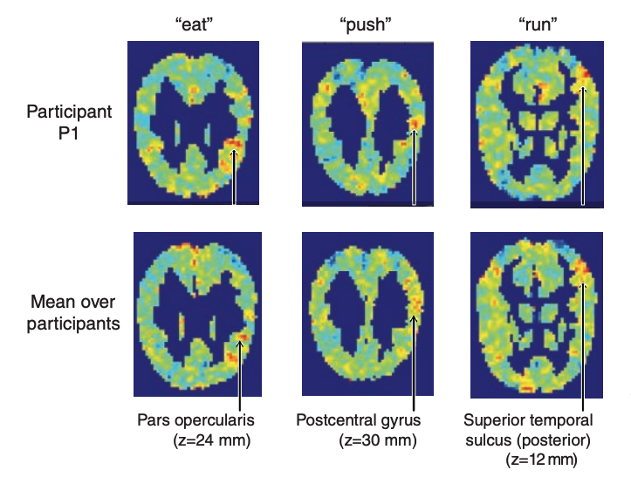
Mitchell et al. (2008), Results (2)
Exploratory Analysis of Learned Mappings:
From the exploratory analysis, authors found that the learned weights of “semantic features” (25 verbs) correspond to existing findings in cognitive neuroscience
E.g. the weight learned for “eat” shows strong activation in the opercular cortex which has been suggested to correspond to the sense of taste in the gustatory cortex
The similarity of the learned weights across participants demonstrates that these semantic features show some degree of commonality across individuals

Slide 21
Paper #2: “The neural architecture of language: Integrative reverse-engineering converges on a model for predictive processing”
Martin Schrimpf, Idan Blank, Greta Tuckute, Carina Kauf, Eghbal A. Hosseini, Nancy Kanwisher, Joshua Tenenbaum, Evelina Fedorenko
bioRxiv

Slide 22
Schrimpf et al. (2020), Overview
Authors performed a systematic study evaluating state-of-the-art transformer models in the tasks of brain image encoding, behavioral data prediction, and next-word prediction
Randomly-initialized networks perform just as well as fine-tuned models, suggesting that the inherent structure of models contributes to their high coherence with brain recordings
For the stimuli evaluated, the best-performing transformer models predict brain responses with 100% accuracy, and this predictive capability generalizes across different brain imaging modalities (namely fMRI and ECoG)

Slide 23
Schrimpf et al. (2020), Method
fMRI data:
Two fMRI datasets were used, those collected by Blank et al. (2014) and Pereira et al. (2018)
Blank et al. (2014): fMRI data was collected from 5 participants, as each listened to eight stories (each story was approximately five minutes in duration)
Pereira et al. (2018): fMRI data was collected from 10 participants, as each read short passages presented one sentence at a time (the total number of sentences each participant read ranged between 243-384, depending on the original experimental condition)

Slide 24
Schrimpf et al. (2020), Method (2)
ECoG data:
There was also an ECoG dataset used, collected by Fedorenko et al. (2016)
Fedorenko et al. (2016): ECoG data was collected from 5 participants, as each read a collection of 80 semantically and syntactically diverse sentences
Across all datasets used, brain recordings were limited to language-selective voxels and electrodes
Thereby, most recordings used were concentrated in the fronto-temporal language-selective network

Slide 25
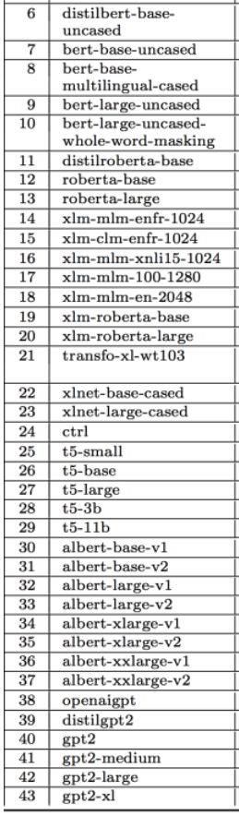
Schrimpf et al. (2020), Method (3)
NLP models:
43 different language models were used—including word embedding models and RNNs—however, the focus of the study was on transformers and attention-based architectures
The 38 transformer models used were from the HuggingFace library, and for each model, only the encoder was evaluated (not the decoder)
Brain image encoding model:
Each model’s representation for the same stimuli participants were presented with (sentences and short passages), were used to train a linear regression model to predict the corresponding brain recordings
Models were trained and evaluated on individual participant’s data

Slide 26
Schrimpf et al. (2020), Method (4)
Evaluation:
As was done in Mitchell et al. (2008), each brain image encoding model was trained on a subset of the data (which varied depending on the brain recording dataset being used) and used to predict the brain recordings corresponding to the left-out data
These predictions of the left-out data were then correlated with the actual data (accounting for the noise ceiling) to determine the final “neural predictivity score”
For each model, only the score for the best-performing layer was reported

Slide 27
Schrimpf et al. (2020), Method (5)
Evaluation:
For behavioral data prediction, each language model was tasked with predicting per-word self-paced reading times for naturalistic stories using a linear regression model trained on the language model’s last layer feature representation
For next-word prediction, models were trained and evaluated on the Wikitext-2 dataset
All the language models were also evaluated on the tasks in the GLUE benchmark

Slide 28
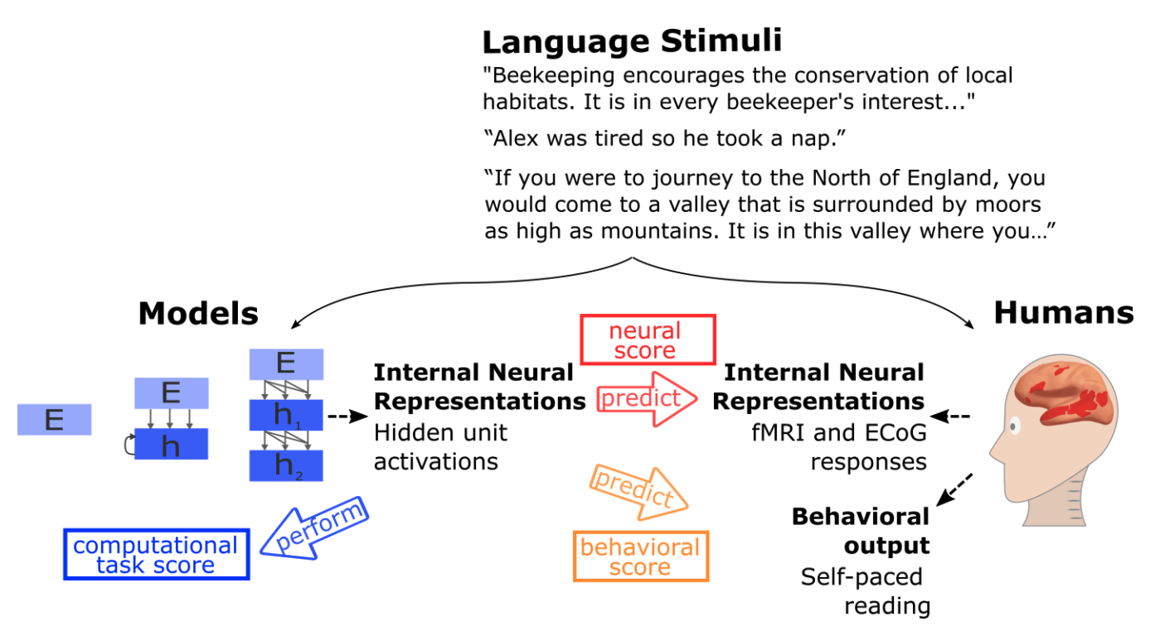
Schrimpf et al. (2020), Method (6)

Slide 29
Schrimpf et al. (2020), Results
Language models’ ability to predict brain recordings was found to generalize across brain imaging modalities (e.g. if a model poorly encodes fMRI responses it will likely also poorly encode ECoG responses)
Generally, the most performant models were transformer models, and models with a greater number of parameters
The best-performing model, GPT-2, explained 100% of the variance of brain recordings in Pereira et al. (2018), i.e. up to the noise ceiling
Randomly-initialized models performed similar to their fully-trained counterparts

Slide 30
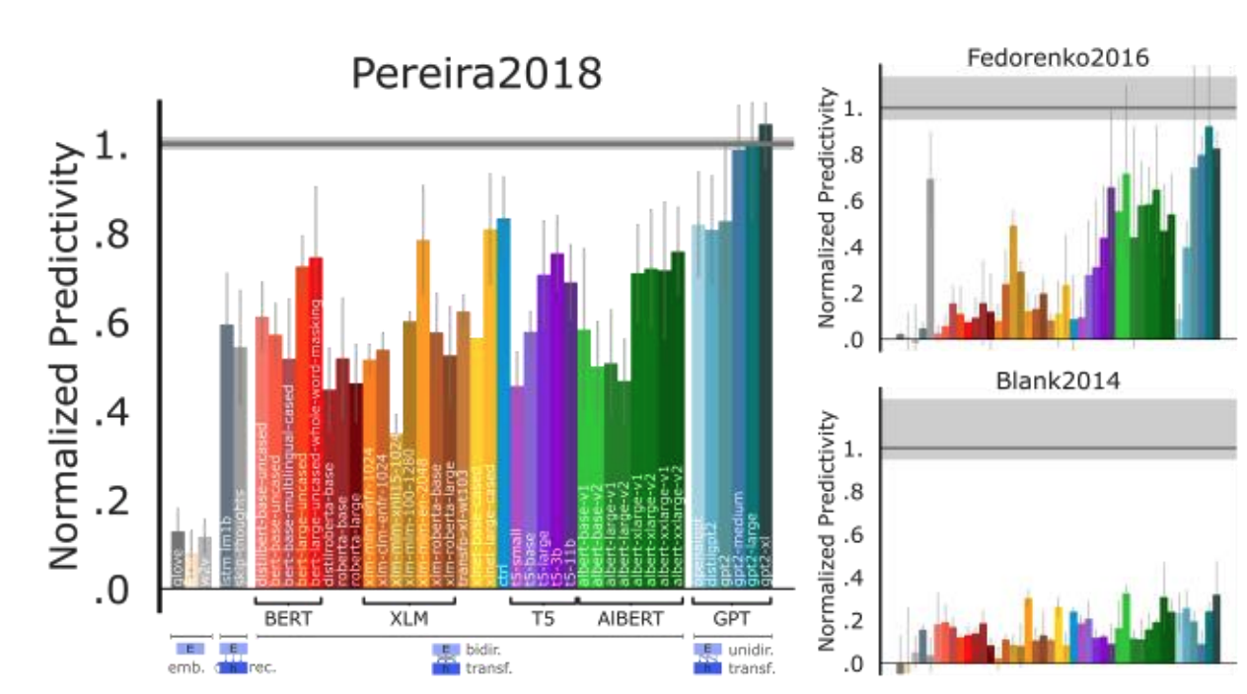
Schrimpf et al. (2020), Results (2)

Slide 31
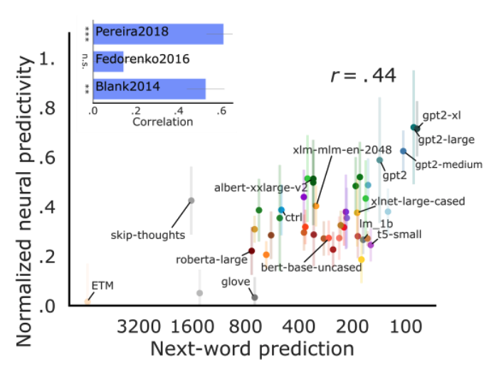
Schrimpf et al. (2020), Results (3)
Correlation Across Tasks
Next-word prediction performance predicted brain image encoding performance
The most performant language model, GPT-2 XL, also achieves the highest neural predictivity score
Next-word prediction and brain image encoding performance correlate with behavioral data prediction performance
The performance on tasks in GLUE (e.g. entailment, sentence grammaticality) did not correlate with neural predictivity performance

Slide 32
Paper #3: “Machine translation of cortical activity to text with an encoder–decoder framework”
Joseph G. Makin, David A. Moses, Edward F. Chang
Nature

Slide 33
Makin et al. (2020), Overview
First study to successfully decode entire sentences from brain imaging data (ECoG in this case)
Previous work has focused on decoding individual words, parts of speech, or portions of longer phrases
Authors frame the task of brain image decoding as a sequence to sequence machine translation task
Best-performing participant model exhibits a 3% WER on a held-out repeat set
For reference, a WER of 25% is considered the upper bound for acceptable performance in speech transcription work
Performance can be improved by cross-participant transfer learning

Slide 34
Makin et al. (2020), Method
ECoG data:
ECoG was collected from participants as each read aloud either a set of picture descriptions (30 sentences) or the MOCHA-TIMIT dataset (460 sentences)
Only data from participants who had repeated trials at least three times were used
Thereby, only data from four participants, across repetitions of 50 unique sentences, was used
Neural activity was recorded from an ECoG array (120-250 electrodes) covering participants’ peri-Sylvian cortices
At each electrode, the high-frequency component (i.e. ‘high-γ’) of the ECoG signal was extracted at 200 Hz

Slide 35
Makin et al. (2020), Method (2)
Brain image decoding model:
Before the brain recordings are provided as input to the language model (RNN), the model effectively downsamples the recordings to 16 Hz using temporal convolution filters (the stride is greater than one)
The encoder RNN receives the downsampled sequences as input, and learns to summarize them into a single high-dimensional encoding (independent of their length) as its final hidden state
Although not used when testing the model, the encoder RNN is also trained to predict a representation of the speech audio signal that corresponds temporally to the ECoG sequence

Slide 36
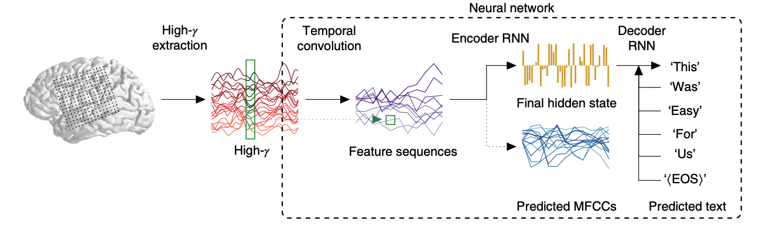
Makin et al. (2020), Method (3)
Brain image decoding model:
The decoder RNN takes as input the final hidden state of the encoder RNN (and is initialized at this state), and at each time step, the decoder RNN is trained to output either a word or the end-of-sequence token given its previous hidden state and output

Slide 37
Makin et al. (2020), Method (4)
Evaluation:
Decoding performance is quantified as the average word error rate (WER) across all evaluated sentences
WER is the minimum number of transformations (deletions, insertions, and substitutions) required to obtain the true sentence, normalized by the true sentence’s length
The authors limit the WER at 100% by assuming an empty sentence would be predicted otherwise

Slide 38
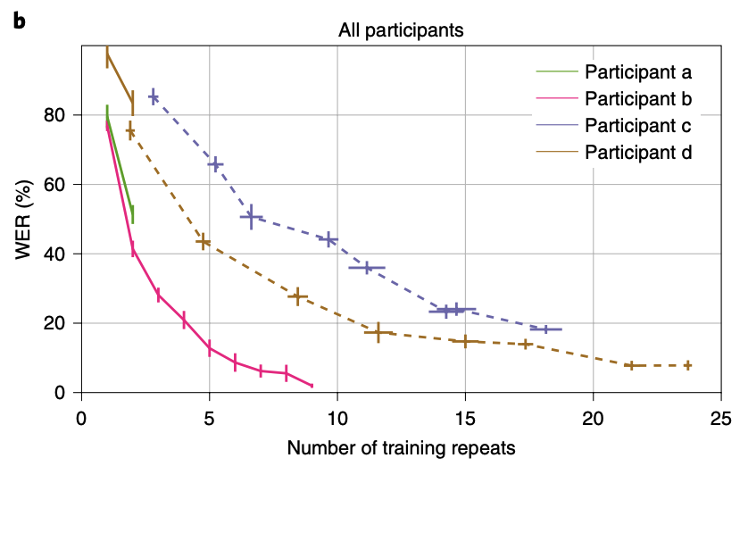
Makin et al. (2020), Results
The mean decoding WER for the full encoder-decoder model ranged between 3%-~50% across participants
The previous state-of-the-art was a WER of 60%
In the models where at least 15 repeats worth of data was available (for the 50 sentences), WER could be driven down to 25%

Slide 39
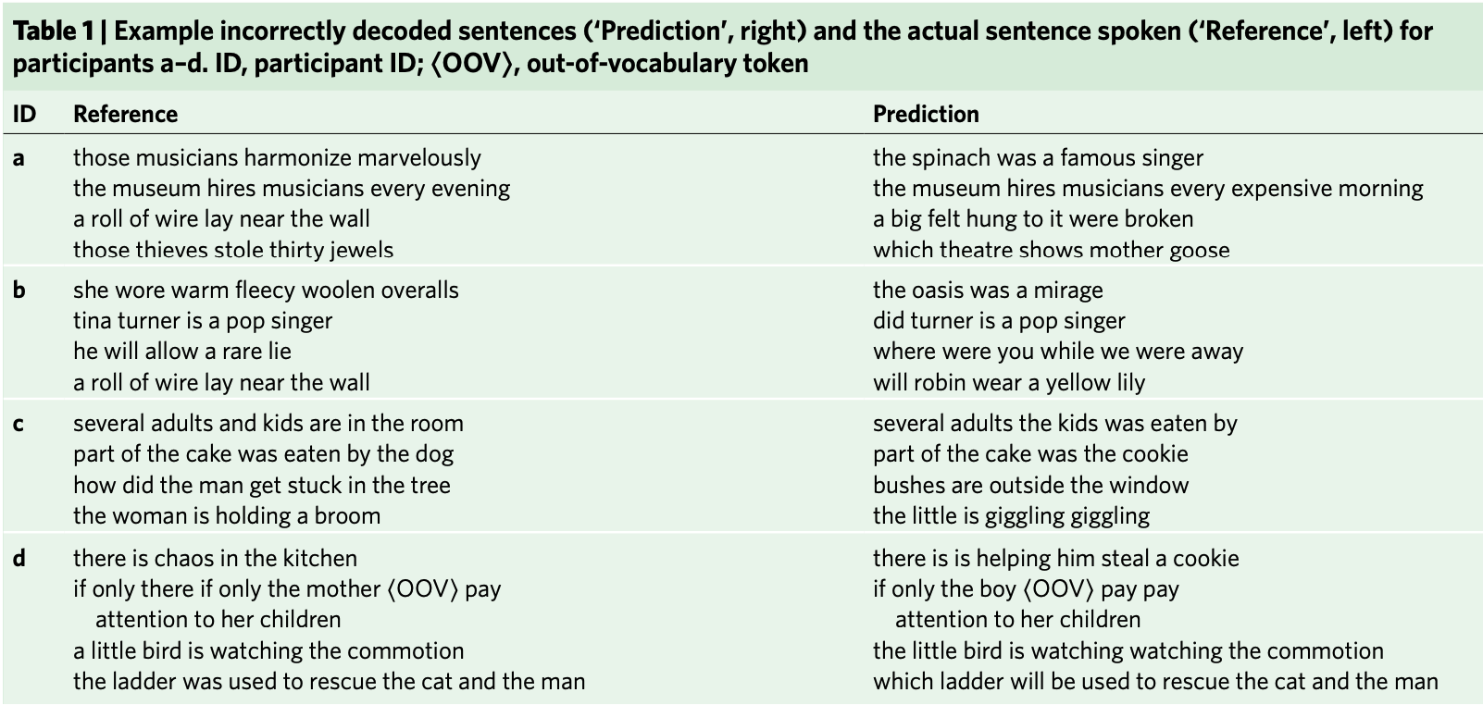
Makin et al. (2020), Results (2)

Slide 40
Makin et al. (2020), Results (3)
Ablation study:
To quantify the contributions of the various elements of the encoder-decoder model, the authors perform an ablation study
Low density, models were trained on a simulated lower density ECoG grid
No MFCC’s, models were trained without requiring the encoder RNN to predict MFCC’s
No conv., the models’ temporal convolution layer was replaced with a fully connected layer
Phoneme-based HMM, instead of decoding word-by-word, the model was used as a sentence classifier based on ECoG-to-phoneme Viterbi decoding
Length info. only, the input ECoG recordings were replaced with Gaussian noise of the correct length (we expect this condition to perform near chance level)

Slide 41
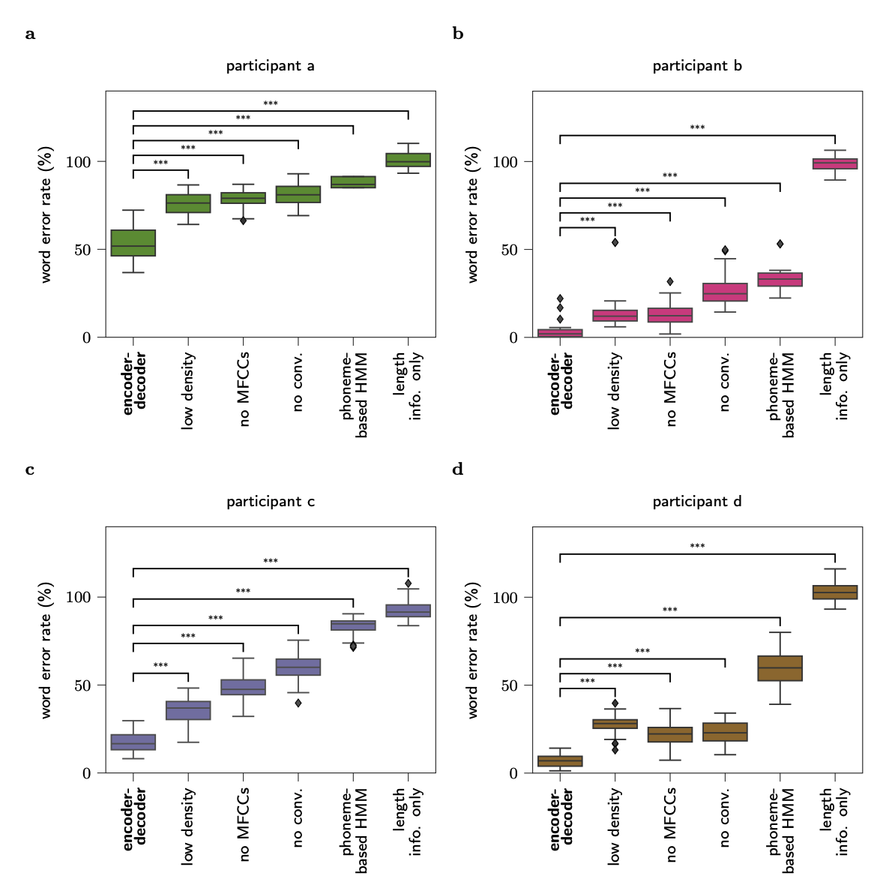
Makin et al. (2020), Results (4)

Slide 42
Makin et al. (2020), Results (3)
Transfer learning:
Since participant a contained the fewest number of repeats among all participants, the authors explored transfer learning
participant TL, cross-participant transfer learning where the model is first trained on the data of participant b (from whom much ECoG data was collected)
task TL, training on sentences outside the 50 sentence test set, i.e. for which there were fewer than 3 repetitions
dual TL, training using both forms of transfer learning described above

Slide 43
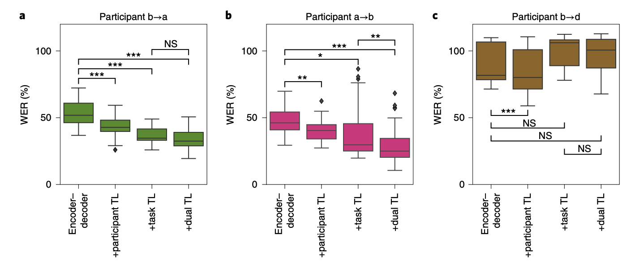
Makin et al. (2020), Results (5)

Slide 44
Why this approach?
The only processing system we have that understands language is the human brain
By assumption that all cognitive processes are manifested in neural activity, language comprehension is as well
Serves as top-down approach
Any theory of language comprehension would rely on cognitive neuroscience for evaluation
E.g. Christos Papadimitriou’s “Assembly Calculus”

Slide 45
Discussion Questions

Slide 46
Q. #1 Do you feel that this work is an appropriate way to approach our goal of understanding how language is comprehended? Why or why not?

Slide 47
Q. #2 What ideas do you have for how cognitive neuroscience can be used to (1) evaluate, (2) improve, (3) or better understand models in NLP?

Slide 48
Q. #3 Thinking more broadly about the relationship between neuroscience and AI, what ideas do you have for how we can continue this “virtuous cycle”?

